Slide 1
LAN Extension into a WAN
Troubleshooting Frame Relay WANs

Slide 2
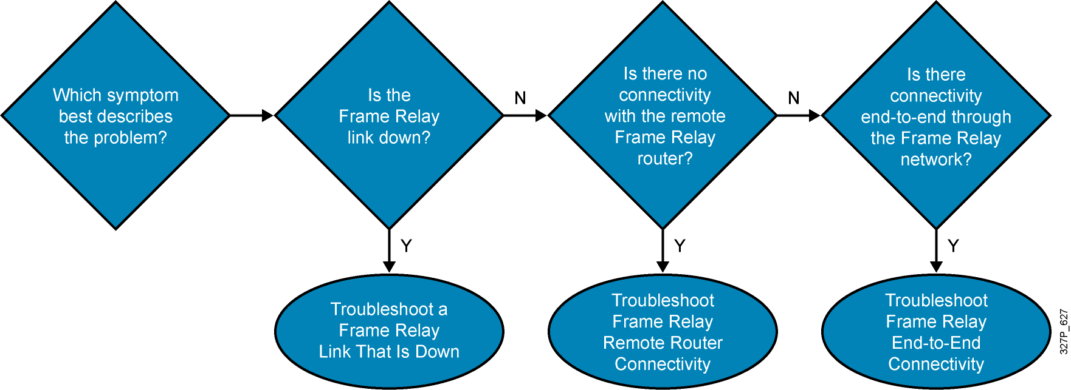
Components of Troubleshooting
Frame Relay

Slide 3
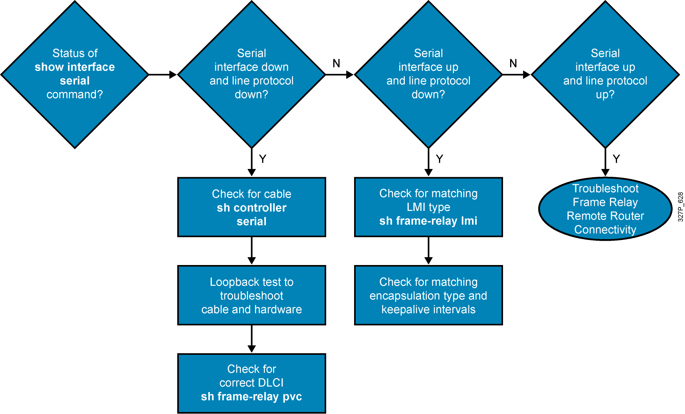
Troubleshooting a Frame Relay Link That Is Down

Slide 4
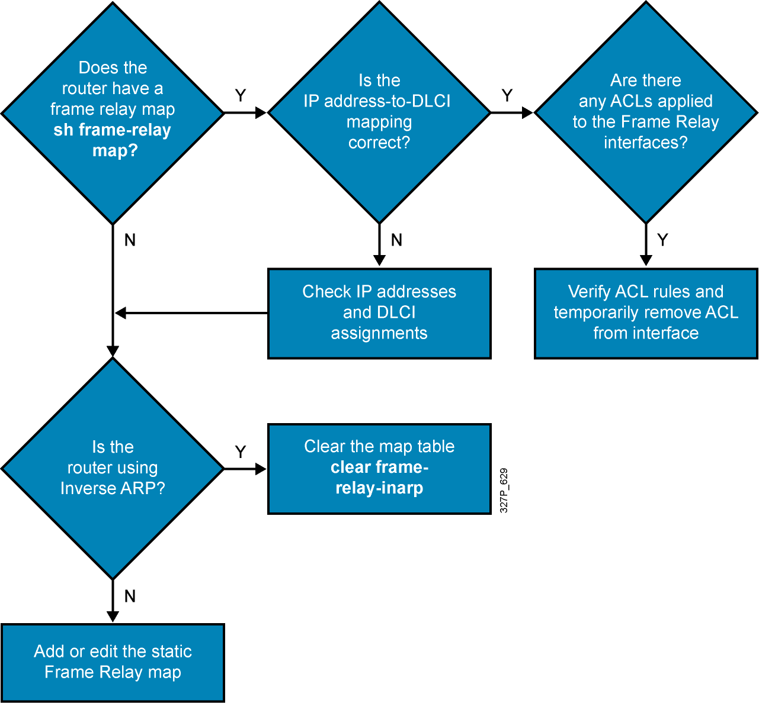
Troubleshooting Frame Relay Remote Router Connectivity

Slide 5
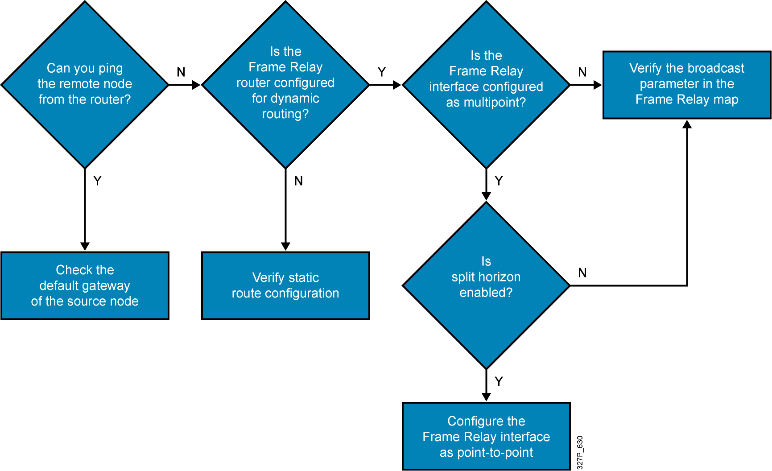
Troubleshooting Frame Relay
End-to-End Connectivity

Slide 6
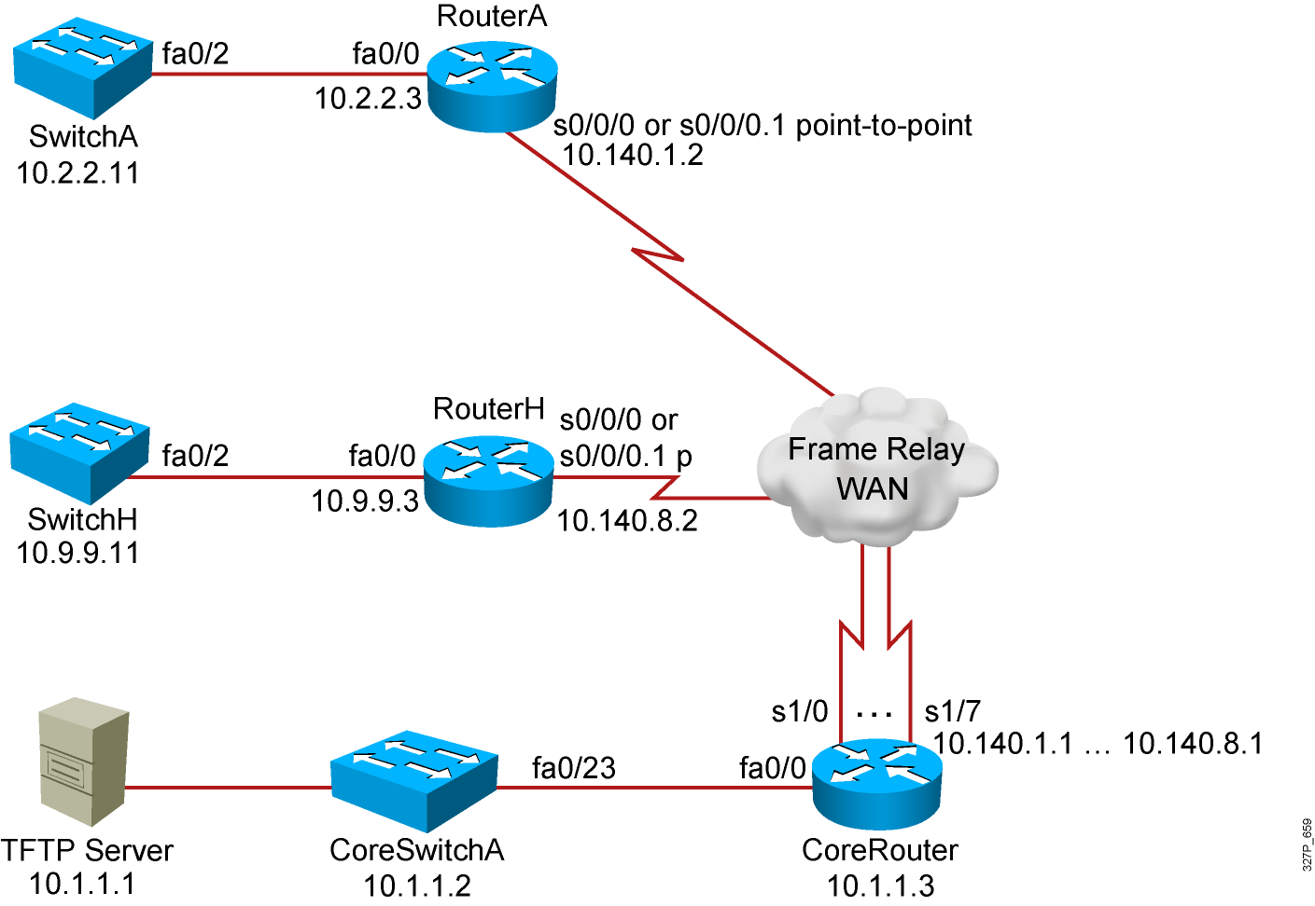
Visual Objective 8-2:
Troubleshooting Frame Relay WANs
WG Router s0/0/0
A 10.140.1.2
B 10.140.2.2
C 10.140.3.2
D 10.140.4.2
E 10.140.5.2
F 10.140.6.2
G 10.140.7.2
H 10.140.8.2
Notes:
Lab 16 Frame Relay
Objectives: Enable the Frame Relay on a serial link.
Purpose: Teach students how to enable Frame Relay.
Laboratory Instructions: Refer to the lab setup guide.

Slide 7
Summary
  There are three aspects of troubleshooting frame relay: troubleshooting the link, troubleshooting the mapping from one router to another, and troubleshooting routing across a frame relay network.
  Use the show interface serial and show frame-relay lmi commands to verify Layer 1 and Layer 2 link failures. Use the show frame-relay map and show frame-relay pvc commands to test connectivity between routers.

